Slide 1


End-To-End Object Detection with Detection Transformers Bismillah Kani AI Researcher CellStrat AI Lab

Slide 2
Table of Contents
Introduction
DETR framework
DETR model
Bipartite matching loss
DETR architecture
Results
Panoptic segmentation
Code demo

Slide 3
Introduction

Slide 4
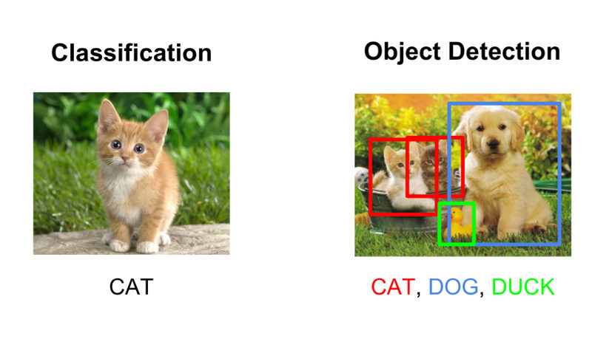
Introduction
Image classification – classify an image into certain category e.g. VGG, ResNet, GoogLeNet, Inception etc. Training data contains images and class labels.
Object detection – identify the location of the objects in an image e.g. R-CNN, Faster R-CNN, YOLO etc. Training data contains images, class labels and the bounding box co-ordinates.
Source [11]

Slide 5
Object detection overview
Two stage detectors - e.g. R-CNN, Faster R-CNN, Mask R-CNN etc.
First stage - Region Proposal Network to generate regions of interests
Second stage - Send the region proposals down the pipeline for object classification and bounding-box regression.
High localization and object detection accuracy. Slower.
Single stage detectors - e.g. YOLO, SSD etc.
Propose predicted boxes from input images without region proposals.
High inference speed. Less accurate.
Source [6]

Slide 6
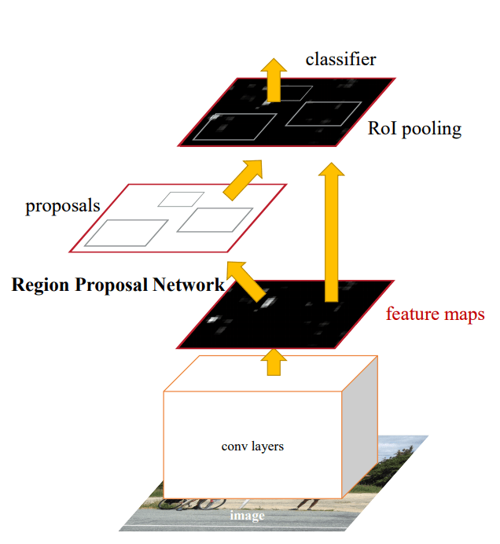
Faster R-CNN
Faster R-CNN is the evolution of R-CNN with improvement in computation efficiency, inference time and performance.
Typical steps of Faster R-CNN:
CNN Feature maps of input image
Region Proposal Network (RPN) is applied on these feature maps and return object proposals along with their objectness score.
A ROI pooling layer is applied on these proposals to bring down all the proposals to the same size.
Classification layer – object class and Regression layer – object bounding box.
Source [5]

Slide 7
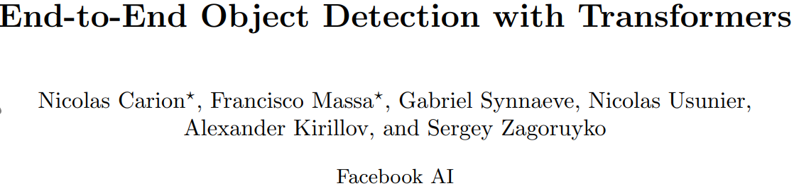
DETR Framework

Slide 8
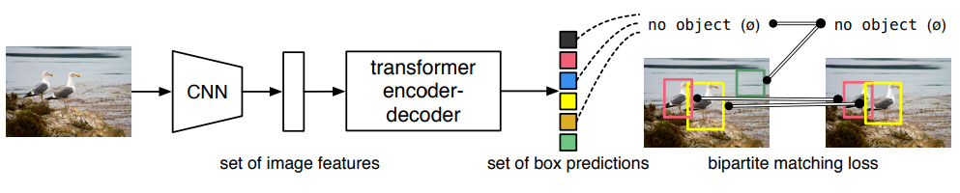
End-To-End Object Detection Transformers
Facebook AI launched a new approach to the object detection by using Transformers which was till now used mainly for NLP tasks.
DETR is a single stage detection architecture which effectively eliminates the need for hand designed components such as anchor generation and non-maximum suppression.
The three main ingredients of this new framework are:
Detection Transformer
A set-based global loss that forces unique predictions via bipartite matching
Encoder-Decoder architecture
Source [1]

Slide 9
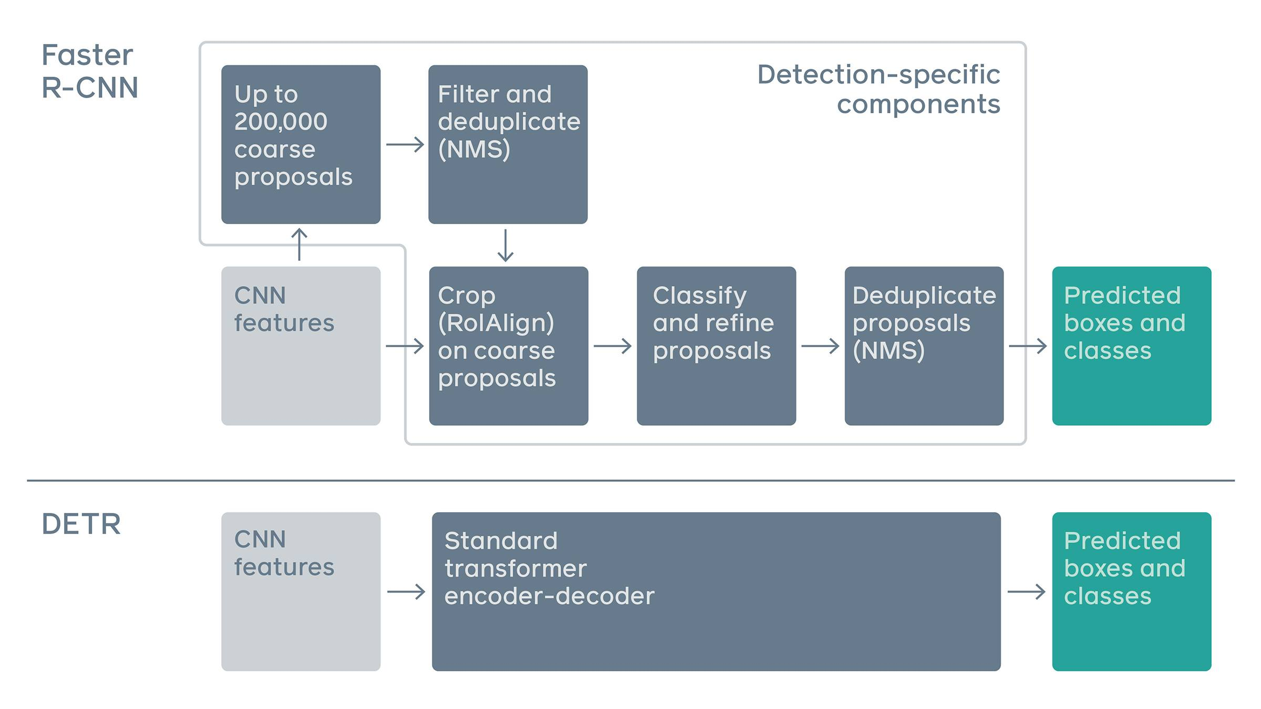
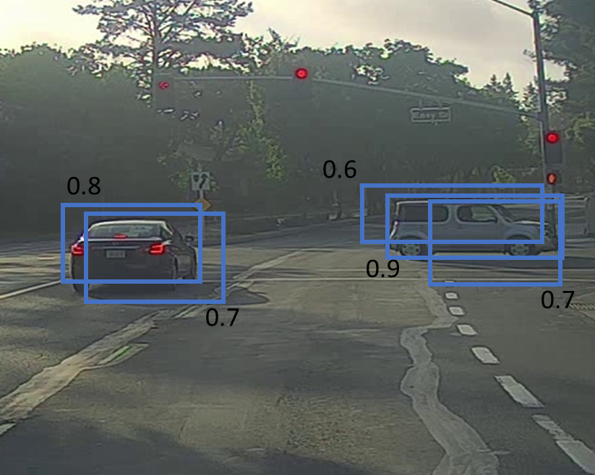
Faster R-CNN vs. DETR
Traditionally in a two stage detector such Faster R-CNN, requires many hand designed components such as region proposal, anchor boxes, non-maximum suppression for object detection.
However, DETR uses a standard transformer architecture to do object detection without the need of hand designed components.
DETR reasons about the relations between the objects and the global image context to directly output the final set of predictions in parallel.
DETR is relatively simple and does not require specialised library. Inference script in 50 lines of code.
Source [2]

Slide 10
DETR model

Slide 11
DETR model
DETR casts the object detection task as an image-to-set problem. Given an image, the model must predict an unordered set (or list) of all the objects present, each represented by its class, along with a tight bounding box surrounding each one.
For this, two things are essential
A set prediction loss that enforces unique prediction
An architecture that predict set of objects in single pass and models their relation
Source [1]

Slide 12
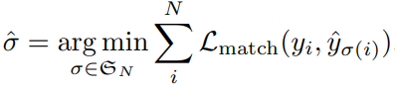
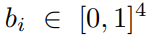
Bipartite matching loss
DETR predicts always fixed size of N predictions. N is significantly larger than number of classes.
How to score the predicted objects with respect to the ground truth? – unique predictions or no duplicate predictions
Bipartite matching ensures that an optimal matching between ground truth and prediction is achieved. To find bipartite matching search for permutation of N elements with the lowest cost:
Lmatch - matching cost is combination of class prediction and box similarity
The optimal bipartite matching is achieved with Hungarian algorithm.
Source [1]

Slide 14
Hungarian Algorithm
The Hungarian method is a combinatorial optimization algorithm that solves the assignment problem in polynomial time O(n^3)
Suppose you have the problem of assigning jobs to the workers. Each worker has different cost for different job. How to assign jobs to workers such that the total cost is minimum.
Worker 1 charges 40 for Job 1, 60 for Job 2 and 15 for Job 3
Worker 2 charges 25 for Job 1, 30 for Job 2 and 45 for Job 3
Worker 3 charges 55 for Job 1, 30 for Job 2 and 25 for Job 3
Condition: No two job can be assigned to one worker nor two worker can be assigned same job
Brute force - Check all combination. n! combinations. 3! = 6. 10! = 3628800, 100! = 9.332622e+157 – Time complexity O(n!)
Source [9, 10]

Slide 15
Hungarian Algorithm
Step 1 – Row reduction : Subtract the smallest entry in each row from all the other entries in the row. This will make the smallest entry in the row now equal to 0.
Step 2 – Column reduction : Subtract the smallest entry in each column from all the other entries in the column. This will make the smallest entry in the column now equal to 0.
Step 3 – Test for an optimal assignment : Draw lines through the row and columns that have the 0 entries such that the fewest lines possible are drawn.
Step 4 – Shift zeros : If there are ‘n’ lines drawn, an optimal assignment of zeros is possible and the algorithm is finished - Go to the Step 5. If the number of lines is less than ‘n’, then the optimal number of zeroes is not yet reached – do shifting : Find the smallest entry not covered by any line. Subtract this entry from each row that isn’t crossed out, and then add it to each column that is crossed out.
Step 5 – Making the final assignment
Source [9, 10]

Slide 16
Hungarian Algorithm – Example 1
j1 | j2 | j3
Step 1: Row reduction
Step 2: Column reduction
w1
w2
w3
40 | 60 | 15
25 | 30 | 45
55 | 30 | 25
15
25
25
25 | 45 | 0
0 | 5 | 20
30 | 5 | 0
25 | 40 | 0
0 | 0 | 20
30 | 0 | 0
0 | 5 | 0
Final cost = 25 + 30 + 15 = 70
Step 3: Test for optimal assignment
Step 5: Final assignment
25 | 40 | 0
0 | 0 | 20
30 | 0 | 0
25 | 40 | 0
0 | 0 | 20
30 | 0 | 0
Source [9, 10]

Slide 17
Hungarian Algorithm – Example 2
j1 | j2 | j3
Step 1: Row reduction
Step 2: Column reduction
w1
w2
w3
30 | 25 | 10
15 | 10 | 20
25 | 20 | 15
10
10
15
20 | 15 | 0
5 | 0 | 10
10 | 5 | 0
15 | 15 | 0
0 | 0 | 10
5 | 5 | 0
5 | 0 | 0
Final cost = 15 + 20 + 10 = 45
Step 3: Test for optimal assignment
Step 4: Shifting zeros
Step 5: Final assignment
15 | 15 | 0
0 | 0 | 10
5 | 5 | 0
10 | 10 | 0
0 | 0 | 15
0 | 0 | 0
10 | 10 | 0
0 | 0 | 15
0 | 0 | 0

Slide 18
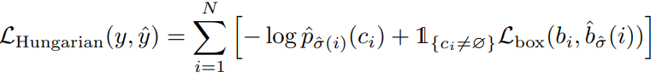
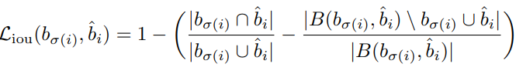
Loss function
Compute loss function for all the pairs matched through bipartite matching.
The loss function i.e. Hungarian loss is a linear combination of class prediction loss and box loss.
The box loss is defined as linear combination of l1 loss and GIoU loss
Generalized Intersection of Union loss,
Source [1]

Slide 19
DETR architecture

Slide 20
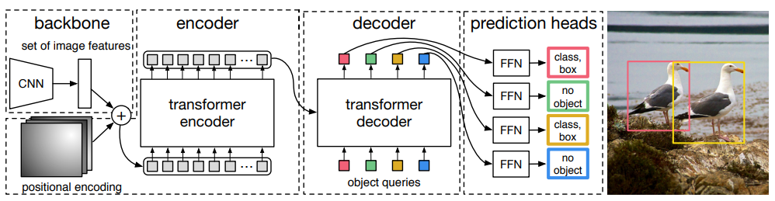
DETR architecture
The three main ingredients of the DETR architecture are,
CNN backbone
Encoder-Decoder Transformer
Simple Feed Forward Network (FFN)
Source [1]
Notes:
DETR uses a conventional CNN backbone to learn a 2D representation of an input image.
The model flattens it and supplements it with a positional encoding before passing it into a transformer encoder.
A transformer decoder then takes as input a small fixed number of learned positional embeddings, which we call object queries, and additionally attends to the encoder output.
We pass each output embedding of the decoder to a shared feed forward network (FFN) that predicts either a detection (class and bounding box) or a “no object” class.

Slide 21
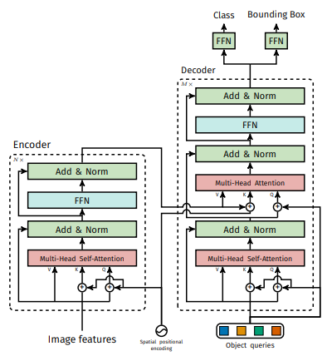
Encoder-Decoder Transformer
DETR uses a conventional CNN backbone to learn a 2D representation of an input image.
The model flattens it and supplements it with a positional encoding before passing it into a transformer encoder. Each encoder layer has a standard architecture with multi-head self attention unit and FFN.
A transformer decoder then takes as input a small fixed number of learned positional embeddings, which we call object queries, and additionally attends to the encoder output. Standard architecture but with parallel decoding.
We pass each output embedding of the decoder to a shared feed forward network (FFN) that predicts either a detection (class and bounding box) or a “no object” class.
Source [1]

Slide 22
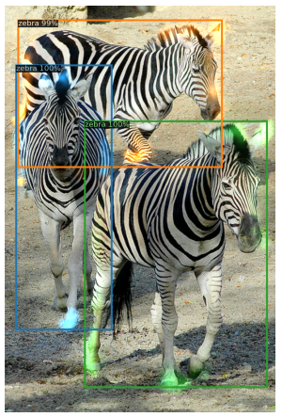
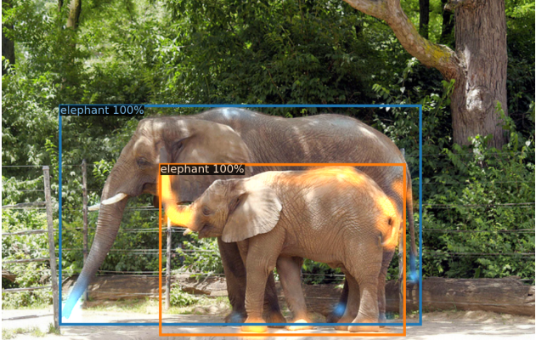

Slide 23
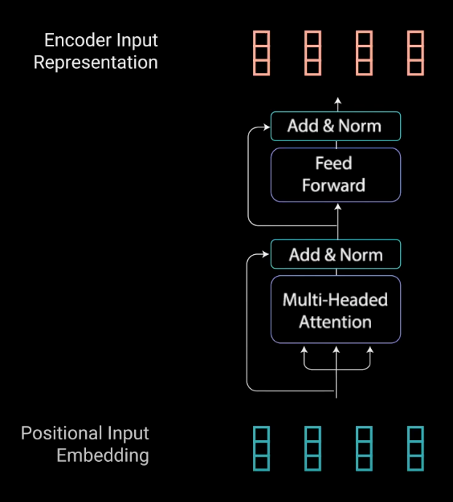
Transformer – Encoder layer
The Encoders layers job is to map all input sequences into an abstract continuous representation that holds the learned information for that entire sequence.
It contains :
Multi-head Attention
FFN
Layer normalization and residual connections.
Source [7]

Slide 24
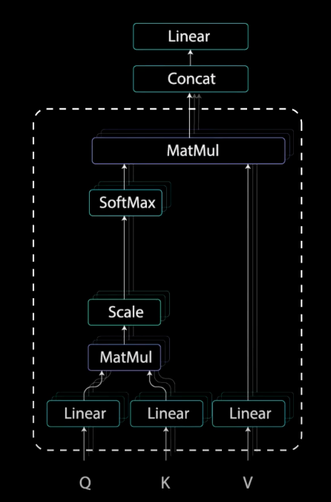
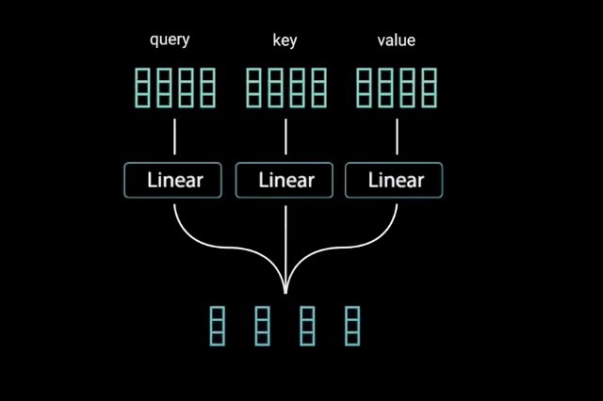
Multi-headed Attention
Multi-headed attention in the encoder applies a specific attention mechanism called self-attention.
Self-attention allows the models to associate each word in the input, to other words.
To achieve self attention, we feed the input into 3 distinct fully connected layers to create the query, key, and value vectors.
Source [7]

Slide 25

Source

Slide 26
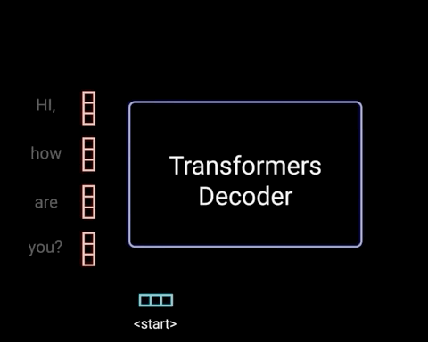
Transformer – Decoder layer
The decoder has two multi-headed attention layers, a pointwise feed-forward layer, and residual connections, and layer normalization after each sub-layer.
These sub-layers behave similarly to the layers in the encoder but each multi-headed attention layer has a different job. The decoder is capped off with a linear layer that acts as a classifier, and a SoftMax to get the word probabilities.
In DETR, the decoder receives queries (initially set to zero), output positional encoding (object queries), and encoder memory, and produces the final set of predicted class labels and bounding boxes through multiple multi-head self-attention and decoder-encoder attention.
Source [7]

Slide 27
Results

Slide 28
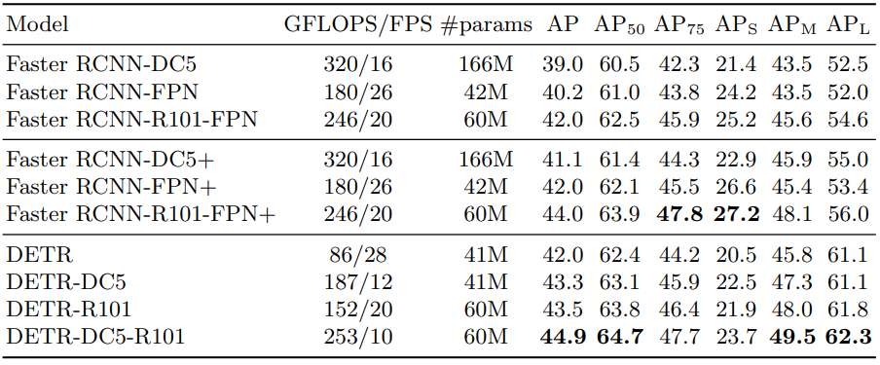
COCO 2017
Dataset – COCO 2017 detection and panoptic segmentation dataset with 118k images and 5K validation images
Backbone – ResNet-50 and ResNet-101
Metrics – Average Precision
Source [1]

Slide 29
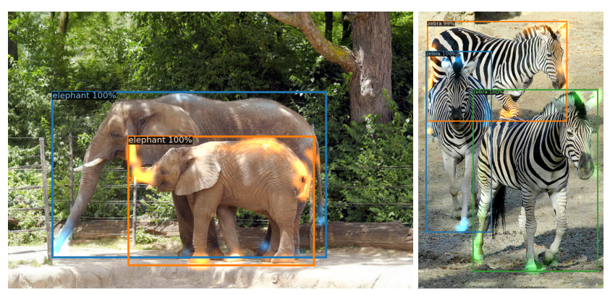
Decoder Attention Visualization
Using self and encoder-decoder attention over these embeddings, the model globally reasons about all objects together using pair-wise relations between them, while being able to use the whole image as context.
Decoder typically attends to object extremities, such as legs and heads.
Source [1]

Slide 30
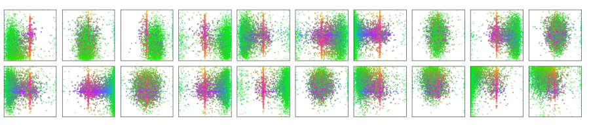
Decoder output slot analysis
DETR learns different specialization for each query slot.
Each box prediction is represented as a point with the coordinates of its center in the 1-by-1 square normalized by each image size.
Each slot learns to specialize on certain areas and box sizes with several operating modes.
Source [1]

Slide 31
Panoptic segmentation

Slide 32
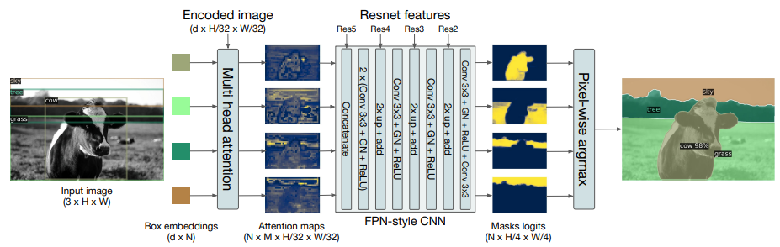
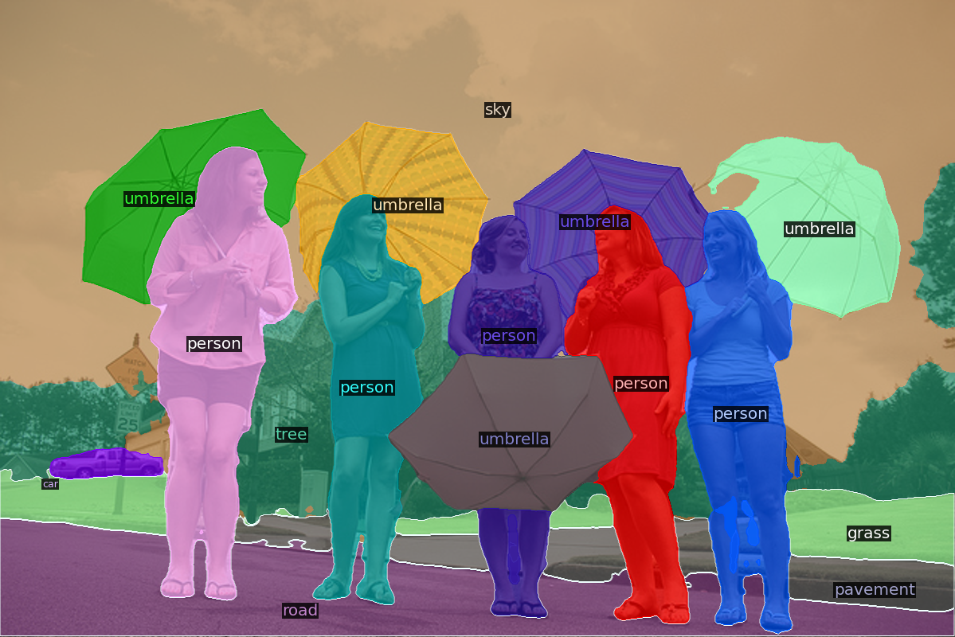
Panoptic segmentation
Panoptic segmentation unifies the typically distinct tasks of semantic segmentation (assign a class label to each pixel) and instance segmentation (detect and segment each object instance).
DETR can be extended by adding mask head on top of decoder outputs for panoptic segmentation.
Source [1]

Slide 33
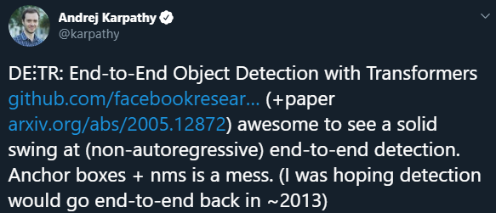
Conclusion
A new paradigm of object detection method is introduced through DETR.
It is the first object detection framework to successfully integrate Transformers as a central building block in the detection pipeline.
Using Transformers in vision may help bridge the gap between the NLP and computer vision communities, both in terms of research innovations and in the way information is reasoned about.
DETR’s novel architecture can also help improve the interpretability of computer vision models. Because it relies on attention mechanisms, it is easy to see what parts of an image the network is looking at when it makes a prediction.
Source [1, 2]

Slide 34
References
https://arxiv.org/pdf/2005.12872.pdf
https://ai.facebook.com/blog/end-to-end-object-detection-with-transformers/
https://github.com/facebookresearch/detr
https://analyticsindiamag.com/object-detection-with-transformers/
https://arxiv.org/pdf/1506.01497.pdf
https://arxiv.org/pdf/1907.09408.pdf
https://www.michaelphi.com/illustrated-guide-to-transformers/
https://giou.stanford.edu/
https://brilliant.org/wiki/hungarian-matching/
https://www.youtube.com/watch?v=cQ5MsiGaDY8/
Introduction to object detection

Slide 35
Code demo
https://colab.research.google.com/drive/1BefJFxNebn8q1QOXYl3cqhvbebyjanJq?usp=sharing

Slide 36
bismillahkani@gmail.com +918123451305
Thank you!
linkedin.com/in/bismillah-kani-49a31115

